Slide 1
WEBSITE PROJECT
DESAROLLO DE APLICACIONES WEB I
Sprint II
LUDOVICO GHERGO
GIACOMO MOSSIO
RAFAŁ JAGIELSKI ANDREA MERICI

Slide 2
Preliminary description
New implementations:
Responsive Web Page
Dynamicity with JSON
Constraint validation
Implementation of JavaScript and Ajax
Implementation of Cookies

Slide 3
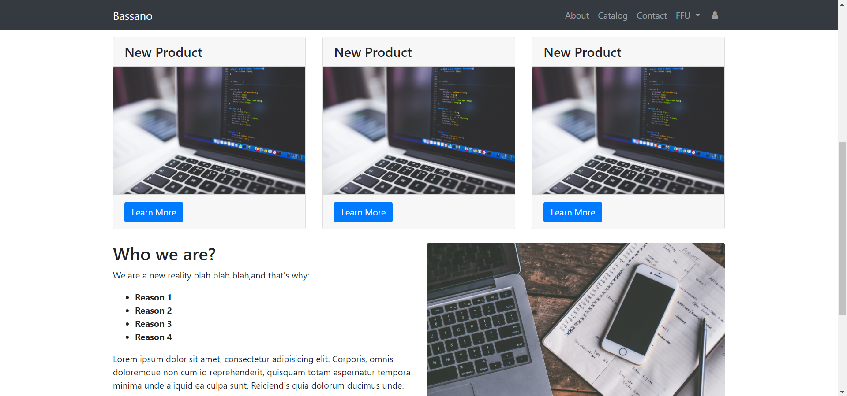
Responsive Web Design
Full screen resolution:
1920 x 900 pixels

Slide 4
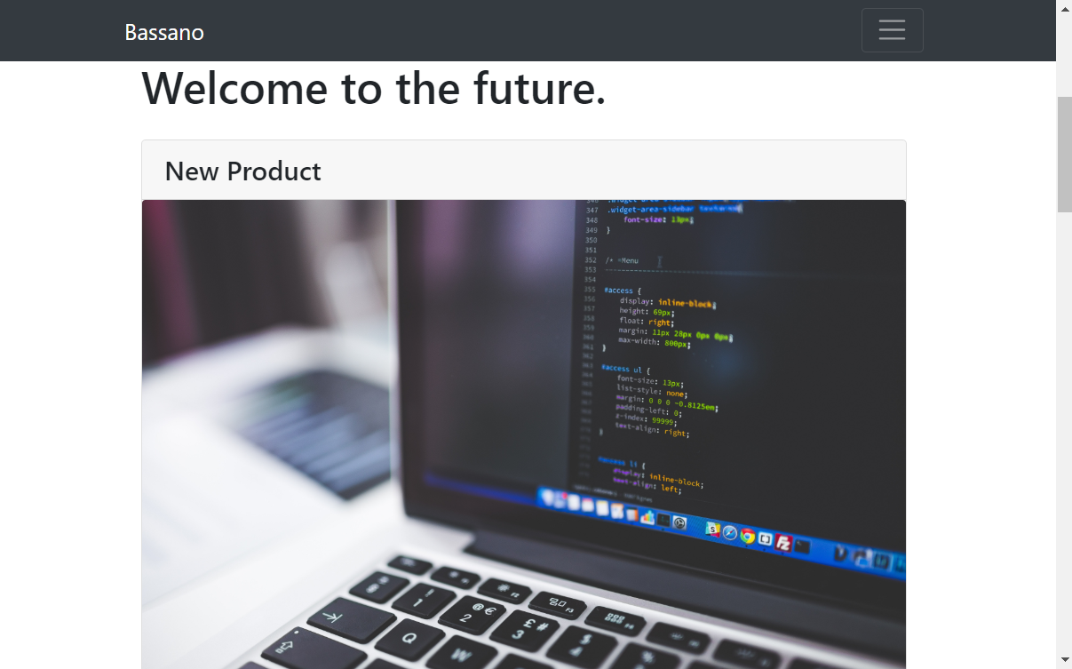
Responsive Web Design
Minimized resolution:
1207 x 573 pixels

Slide 5
Dynamicity with JSON
We take the essentials data from a remote json, which allow us to make lighter our website.
When the catalog page is shown, the page using JS will take the name, description, image from the json. When we change page of the catalog it will be refreshed with new products.
Everytime we click on a product, the site will use a cookie to know which product read from JSON.
The comments are dynamic too thanks to JSON

Slide 6
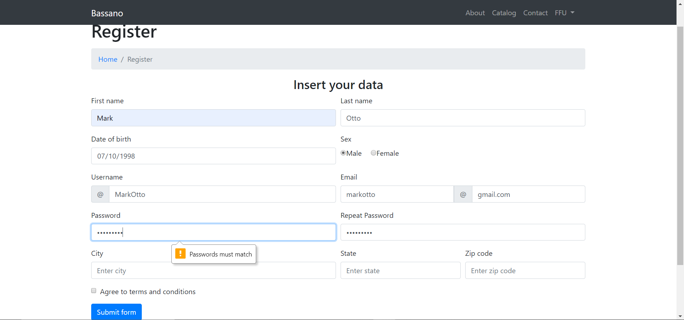
Constraint Validation
Using types and attributes of HTML
Using JavaScript for matching passwords

Slide 7
Implementation of JavaScript and AJAX
We implemented the Javascript & Ajax using an external file (.js) and inpage scripts (<script> tag).
With JS we did the convalidation and the cookie management, with Ajax we managed the Json and dynamicity of the website.

